Slide 1
Continuous Annealing Line Simulator (CAL)
Conceptual Design Review

Slide 2
System Overview: Concepts
Annealing is the process of heating a material above its recrystallization temperature, then cooling it to room temperature.
This process changes the metal’s physical properties.
The CAL-Simulator provides a small scale simulation of the annealing process for Advanced High Strength Steels used in the automotive industry.
Our group will work on several improvements to the CAL-Simulator.

Slide 3
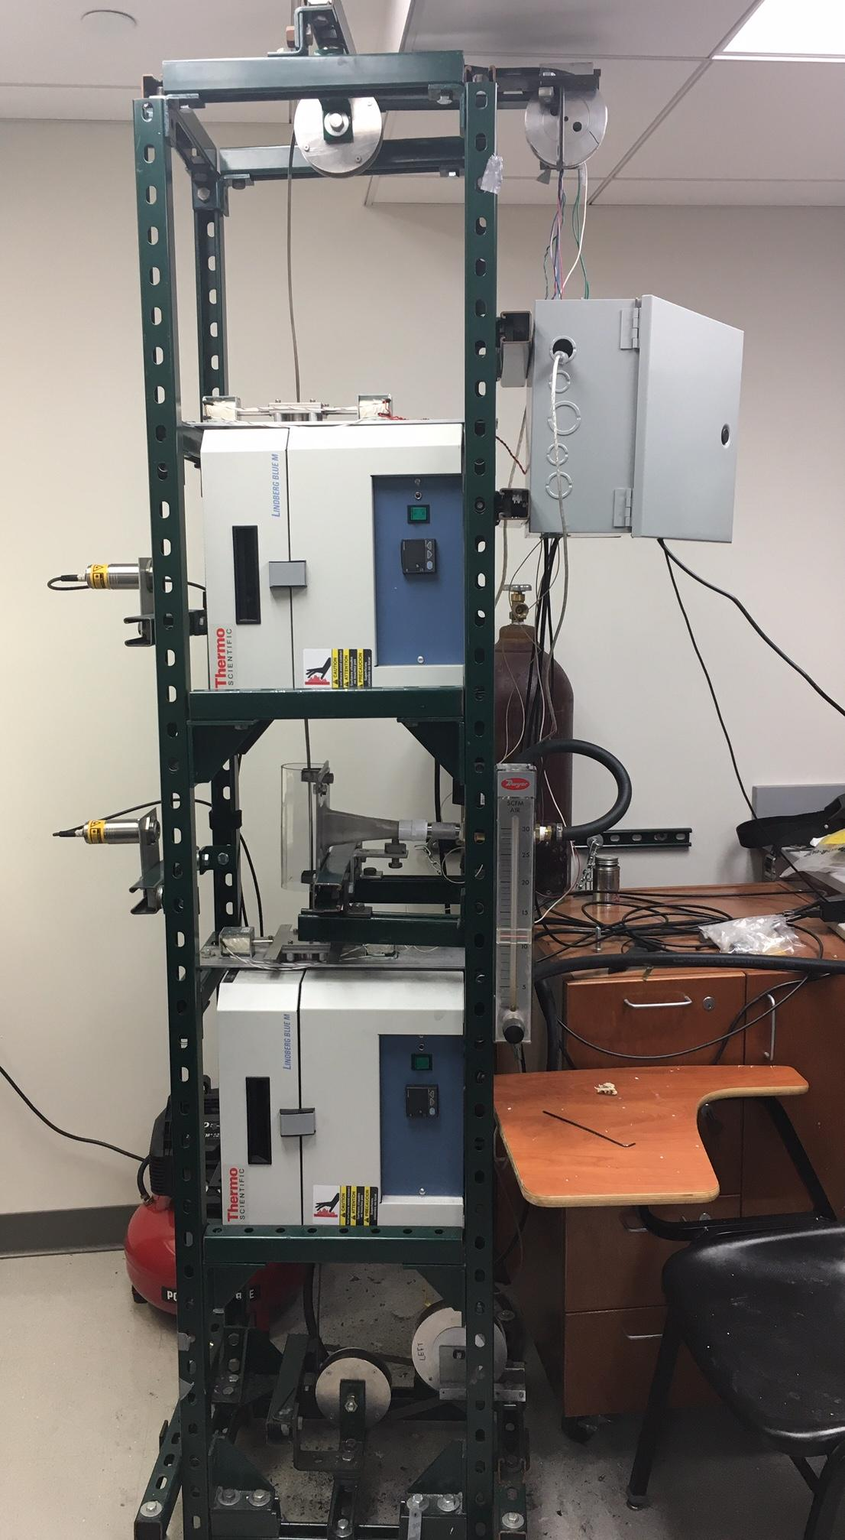
CAL: Continuous Annealing
Line Simulator
Picture of the pre-existing system

Slide 4
System Overview:
Sample Model
Sample Annealing Process:
1.) Sample starts at Cooling Area
2.) Move to Top Furnace for initial annealing treatment
3.) Move to Cooling Area to be rapidly cooled
4.) Continue to second furnace for heat treatment
5.) Move to staging and un-staging area

Slide 5
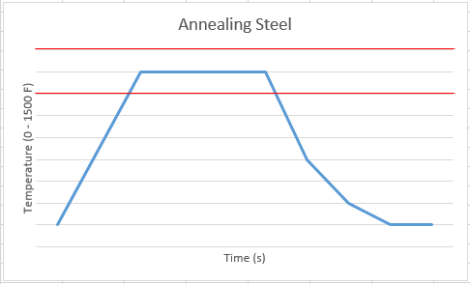
AHSS (Advanced High Strength Steel)
Notes:
Annealing Range: 500 - 1500 F
Yields Two Materials:
Ferrite
Austenite
Within the temperature bounds these two materials are produced at varying ratios:
Current point 50/50 ratio
Austenite + Rapid Cooling = Martensite

Slide 6
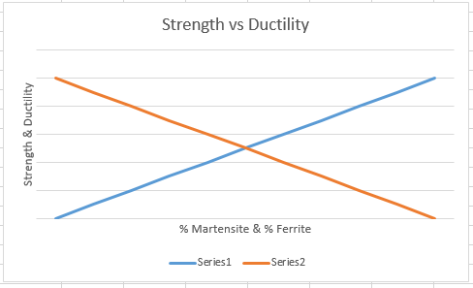
Resulting Properties
Notes:
This is from a conversation with Professor Garcia about annealing advanced high strength steel samples:
Blue line is % Martensite
Orange line is % Ferrite
More Martensite More Strength, but Less Ductility
Or
More Ferrite More Ductility, but Less Strength

Slide 7
Requirements
Goal: Optimize the already existing AHSS annealing system for the Ferrous Metallurgy Group in the MEMS department.
The CAL simulator shall allow the lower furnaces gate to open and close so the sample can pass into the cooling area or the furnace.
A third sensor shall be introduced into the system to provide accurate temperature reading of the sample while in the lower furnace.
The CAL simulator software shall track and place the sample position within ¼ inch of its desired physical location.

Slide 8
Problems
Our design involves solving 3 problems:
The Gate Control
The Sample Positioning Control
Sample Temperature in Secondary Furnace

Slide 9
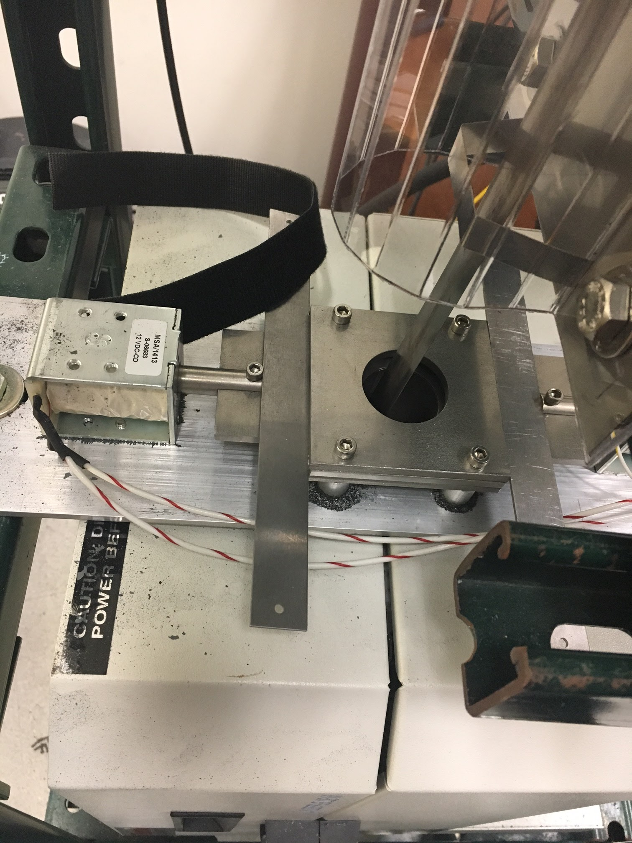
Problem: Gates
Control system for the bottom furnace gate is malfunctioning.
The gate shall open automatically when the sample passes through, and remain closed at all other times.
Gate and position inaccuracy causes the sample to become stuck during simulation.
The gate being open cools the sample slightly during the annealing process causing inaccurate test results.

Slide 10
Current Gate Positions

Slide 11
Proposed Solutions: Gate Malfunction
Replace the existing gate and rewrite system
Rewrite the gate control logic

Slide 12
Gate Solution 1: Replacement
Replace the actuator motor controlling the gate and associated circuitry
Rewrite the code for the gate motor to operate as specified

Slide 13
Replacement: Pros And Cons
Complete control over gate and knowledge of the interface
Can provide a second gate in the process for more accurate readings
Need to replace the existing system
Increased cost
Would possibly cause simulation down time

Slide 14
Gate Solution 2: Reassess Logic
The existing system has worked appropriately in the past, but coding assumptions are creating inaccuracies with gate functionality.
This issue can simply be solved by fixing the simulation and creating a more generalized solution for gate control.

Slide 15
Debugging: Pros And Cons
Pros:
Low cost
Easy to implement
No simulation down time
Cons:
May be a side effect of the positioning system

Slide 16
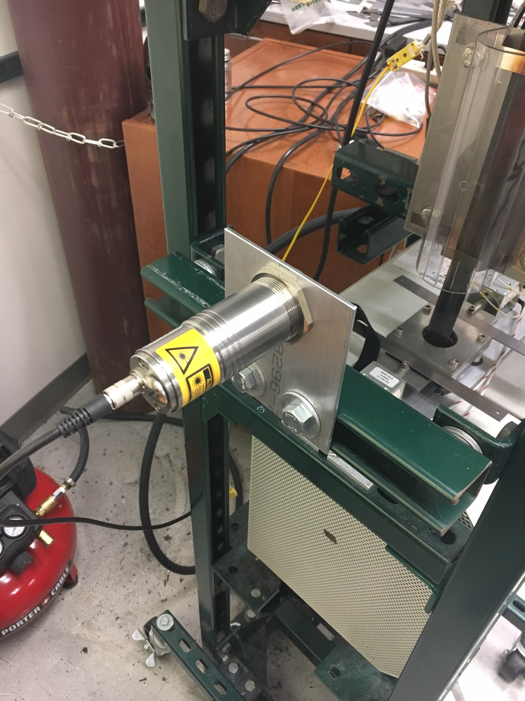
Problem: Temperature
The lower furnace does not currently have an integrated temperature sensor to monitor the temperature of the sample while being heated in the furnace, resulting in unknown heating of the sample

Slide 17

Proposed Solutions: Temperature Control
Install a thermocouple temperature sensor
Install an infrared temperature sensor

Slide 18
Temperature Solution 1: Thermocouple
Install Thermocouple in a fixed position or an automated system to position the Thermocouple near the sample
Install circuitry/software to interpret Thermocouple voltages as temperature measurements

Slide 19
Thermocouple : Pros and Cons
Pros:
Inexpensive
Simple circuit
Easy to retrieve readings from sensor
Cons:
Thermocouple must be almost touching sample to have accurate reading
If automated movement, requires control software/circuitry
If fixed, may block sample’s path
Could complicate simulation

Slide 20
Temperature Solution 2: Infrared Sensor
Install Infrared Sensor
Install Circuitry/Software to read data from sensor

Slide 21
Infrared Sensor: Pros and Cons
Pros:
Existing Circuitry and Software
Stationary and Distanced from Sample
Cons:
Comparably more expensive

Slide 22
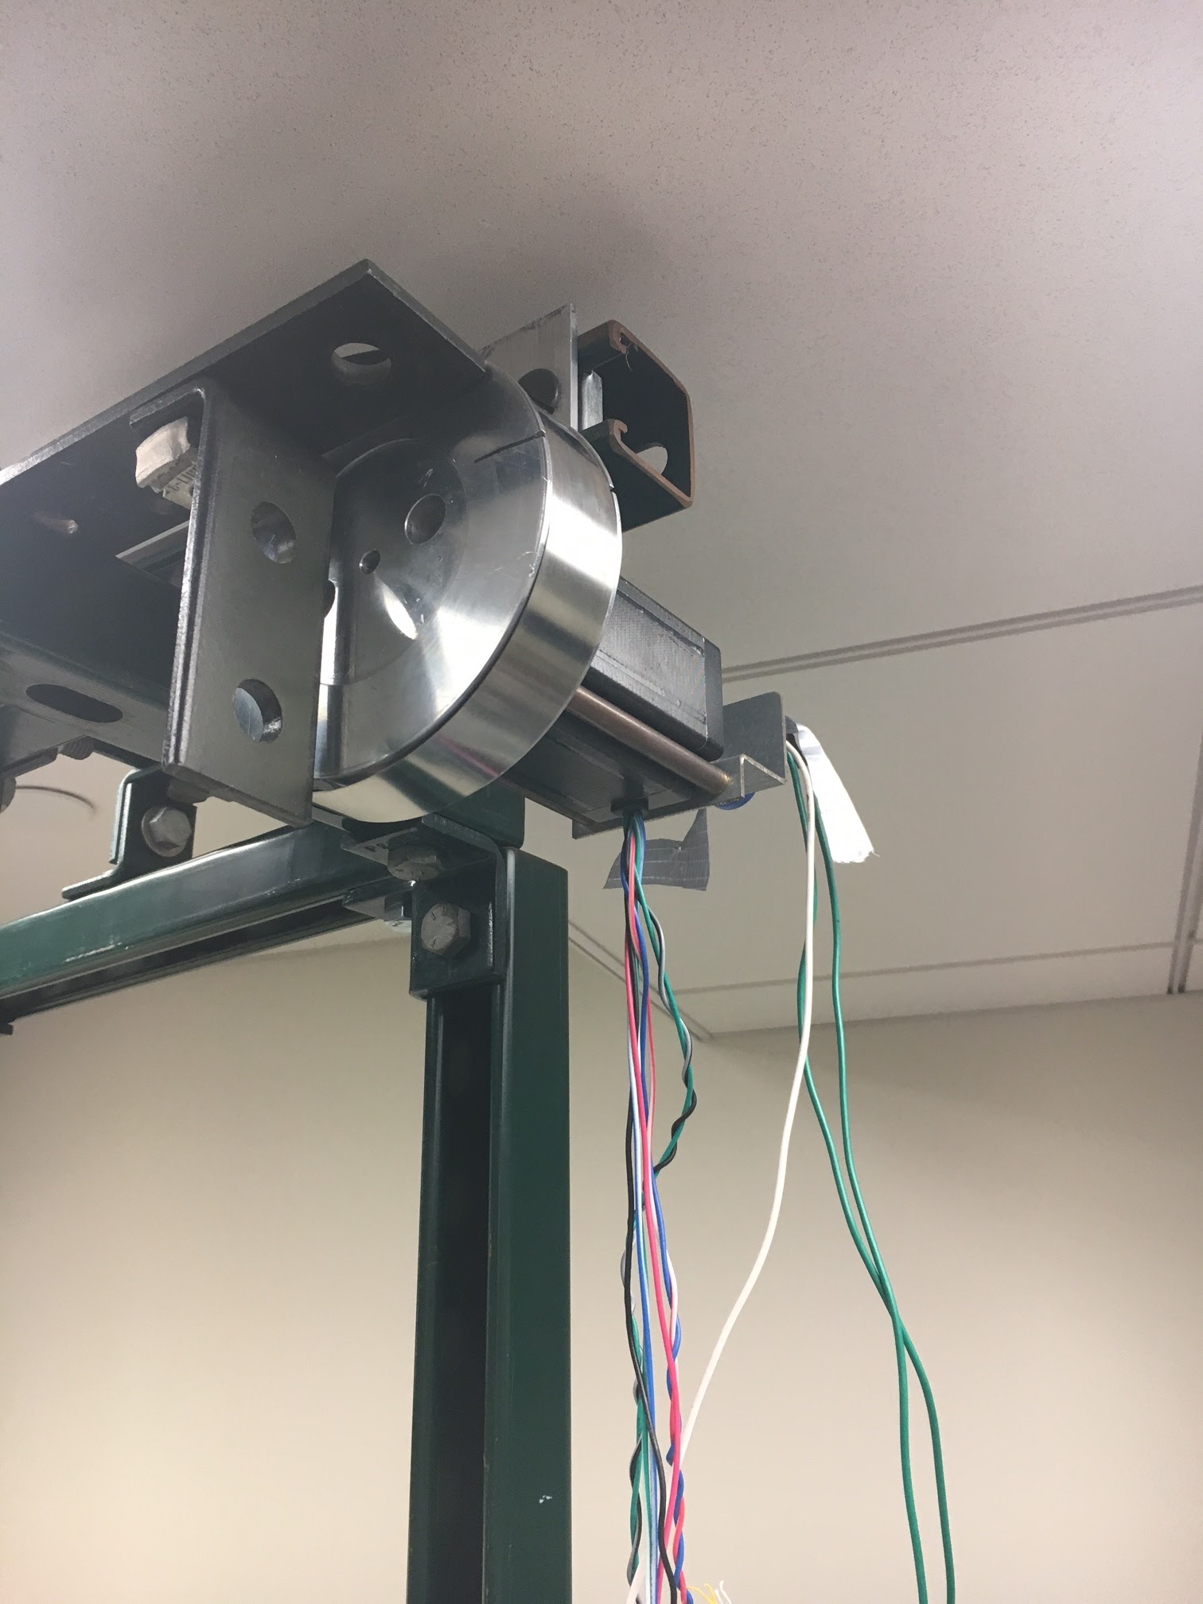
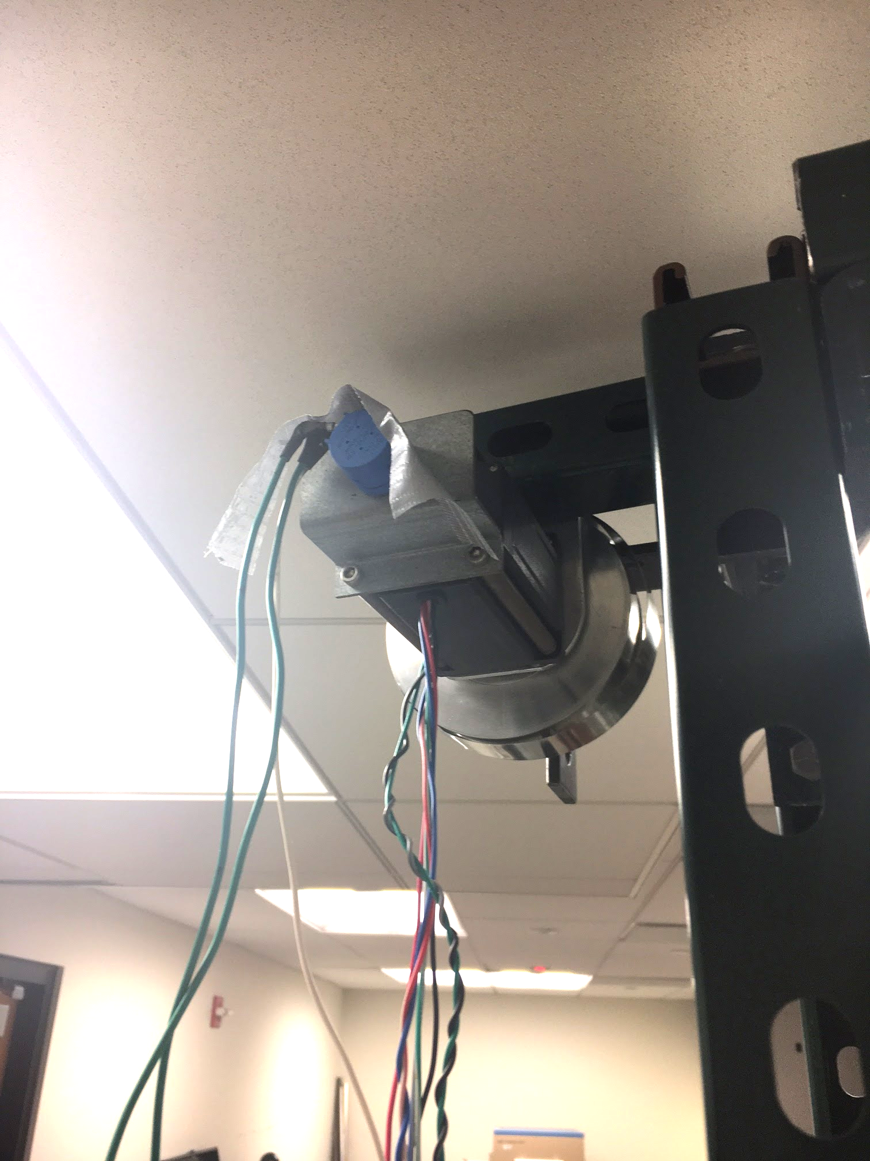
Problem: Positioning
System errors result in the software’s defined position for the sample being incorrect, leading to the sample being improperly heated
May also be contributing to the gate control issue

Slide 23
Proposed Solutions: Positioning
Replace current positioning system
more precise/robust stepper motor
Add a calibration mode to set the position

Slide 24
Positioning Solution 1 : Replace Current System
Replace strip transport system with alternative
Must be able to pass through the gates
Must withstand temperatures
Transport system cannot add strain to the sample
Create control circuitry and software for new system

Slide 25
Replace Current System: Pros and Cons
Pros:
Will fix the issues caused by the current system
Cons:
Requires Time
Added Cost
Requires Mechanical system modification

Slide 26
Positioning Solution 2 : Calibration Mode
Use the existing system
Add software to calibrate the positioning each time it is turned on

Slide 27
Calibration Mode: Pros and Cons
Pros:
Low cost
Sample position will be known for each simulation
Won’t require simulator to be down
Cons:
Must be performed each time the machine was turned on
The furnace may not be able to preheat during calibration process

Slide 28
 | Simulator Down Time (5) | Simulation Improvements (3) | Installation (2) | Fitness
Gate Solutions
Replace Gate | Low - will halt progress for simulation during replacement 5 x 1 = 5 | High - gate runs smoothly during simulation 3 x 3 = 9 | Low - involves installation of a new gate. 2 x 1 = 2 | 16
Debug Gate | High - gate control can be modified and tested without effect on simulation 5 x 3 = 15 | High - gate runs smoothly during simulation 3 x 3 = 9 | High - utilizes existing system. 2 x 3 = 6 | 30
Position Solutions
Replace Current System | Low - positioning system would be completely offline preventing simulation until installation is completed. 5 x 1 = 5 | Moderate - Cause of the positioning error would be eliminated. 3 x 2 = 6 | Low - Installation of new system would increase cost and take more time. 2 x 1 = 2 | 13
Calibration Mode | High - debugging, calibration, and testing can be done while being minimally invasive to simulations. 5 x 3 = 15 | High - provides dynamic calibration of the pre-existing system with higher accuracy 3 x 3 = 9 | High - no installation necessary 2 x 3 = 6 | 30
Temperature Solutions
Install Thermocouple | High - Simulations will be able to be run during installation process, due to complexity of the mechanism. 5 x 3 = 15 | Moderate - Data can be collected for the lower furnace 3 x 2 = 6 | Moderate - Mechanism may be difficult to install without interfering with the sample's movement 2 x 2 = 4 | 25
New IR Sensor | High - Simulations will be able to be run during installation process. Sensor is minimally invasive. 5 x 3 = 15 | High - Data can be collected with a higher precision. 3 x 3 = 9 | High - Non-intrusive. It will be the simplest to install. 2 x 3 = 6 | 30

Slide 29
Recommended Design Solutions
Gate
Gate Solution 2 : Debug the gate - Lower cost, simpler implementation
Temperature Control
Temperature Solution 2 : New IR Sensor - existing software/circuitry
Sample Positioning
Positioning Solution 2 : Calibration Mode - Simple, low cost

Slide 30
Risk Assessment
 |  | Consequences
 |  | MINIMAL | MINOR | MODERATE | SIGNIFICANT | SEVERE
Probability of Occurrence (%) | Level 5: 81-100%
 | Level 4: 61-80% |  | Simulation time prevents us from implementing the design
 | Level 3: 41-60% |  |  | Unable to develop remotely, due to environmental/hardware constraints | Resources not available in time | Lack of time for solution implementation
 | Level 2: 21-40% |  | Lack of understanding of existing code base | Complications interfacing with hardware | Break code base interfering with sample testing | Simulator breaks during our design process
 | Level 1: 0-20% | Poorly written code | Additional funding is unavailable | Member of group drops class | System crash resulting in loss of code base | Misunderstanding customers expectations

Slide 31
Maintenance and Support
We will provide documentation to explain our design
We will provide documentation and comments to explain our code
A schematic of the control system will be provided
The system code will be provided
Our design solution must work for the lifetime of the CAL simulator

Slide 32
Questions...

